Slide 1

Housing Voucher Mobility
In Cuyahoga County
Michael Lepley
Senior Research Associate
mlepley@thehousingcenter.org

Slide 2
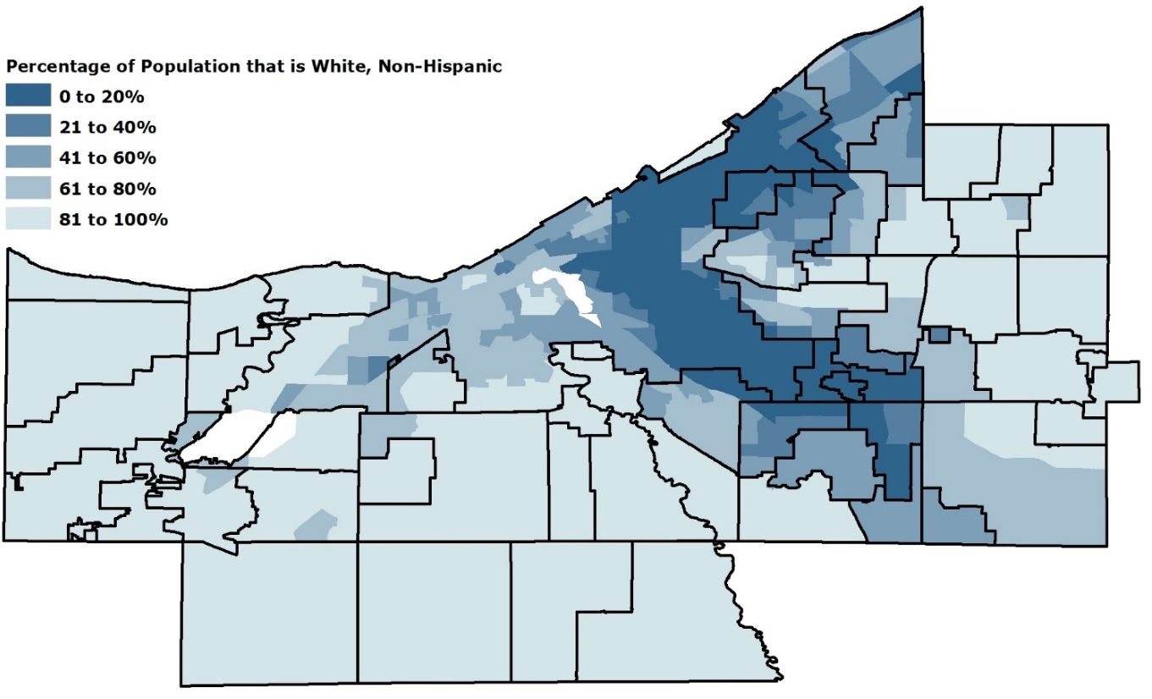
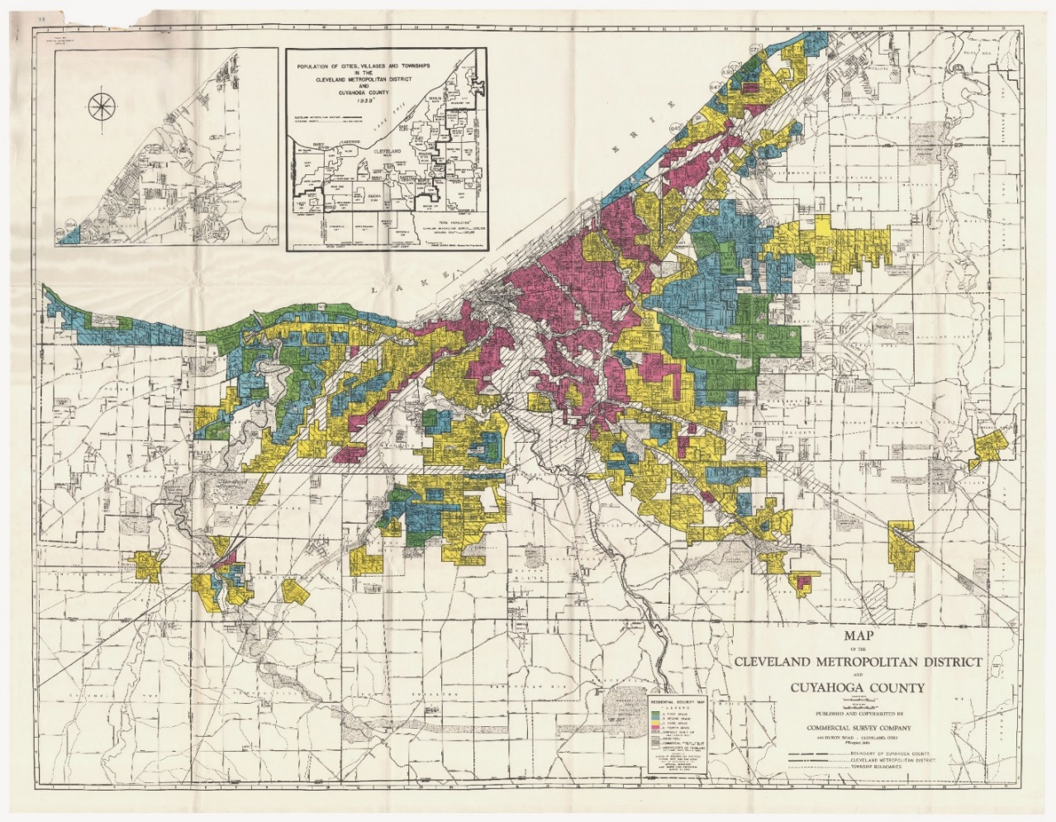
1. Cleveland is the fifth most segregated large city in the United States for African Americans.

Slide 3
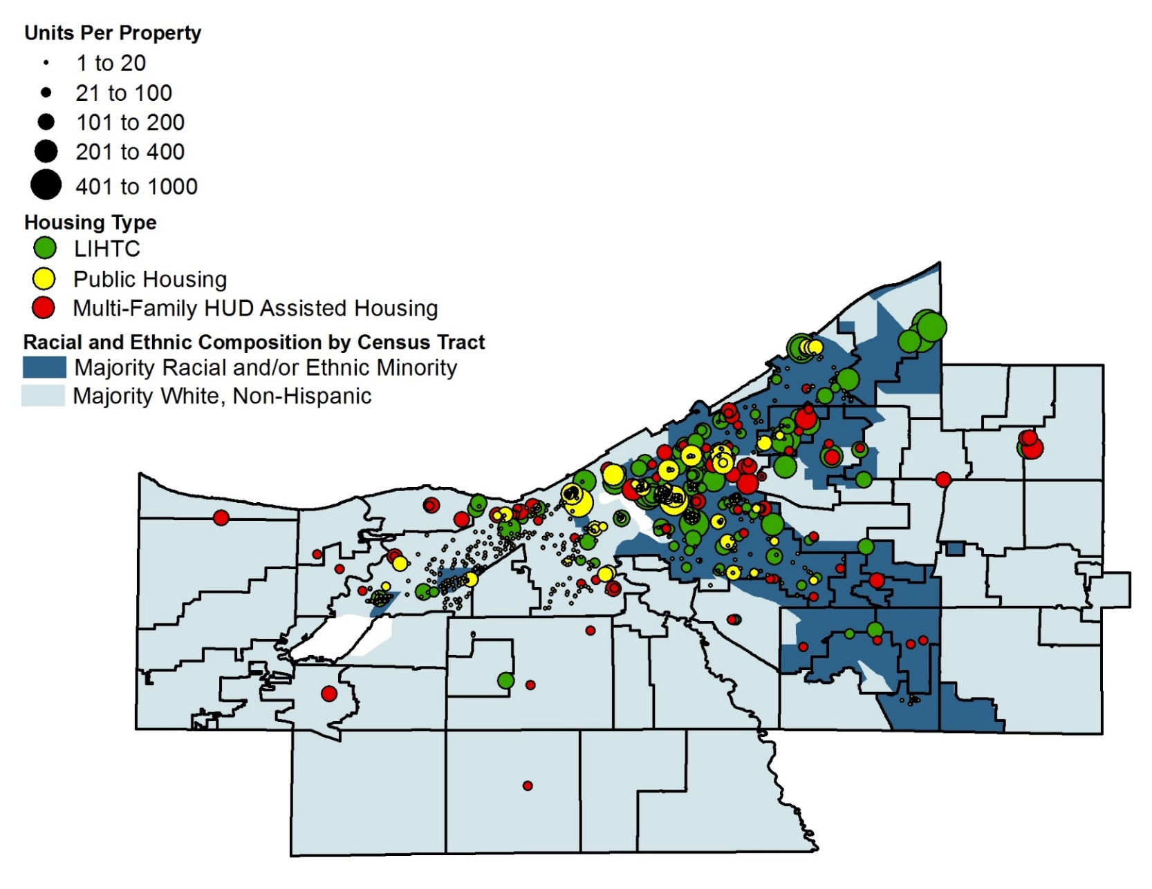
2. Public and subsidized housing has contributed to racial segregation.

Slide 4
3. There is a moral imperative to end de facto and de jure segregation.
Segregation facilitates:
Disinvestment by local governments and private businesses
Predatory business practices
Abusive and predatory criminal justice practices
The prevention of wealth distribution
Limited access to equitable public services
The perpetuation of inequality
Damaging myths and stereotypes on the basis of race
Housing mobility is a proven economic development strategy.
4. There is a legal imperative to end segregation under the Fair Housing Act.

Slide 5
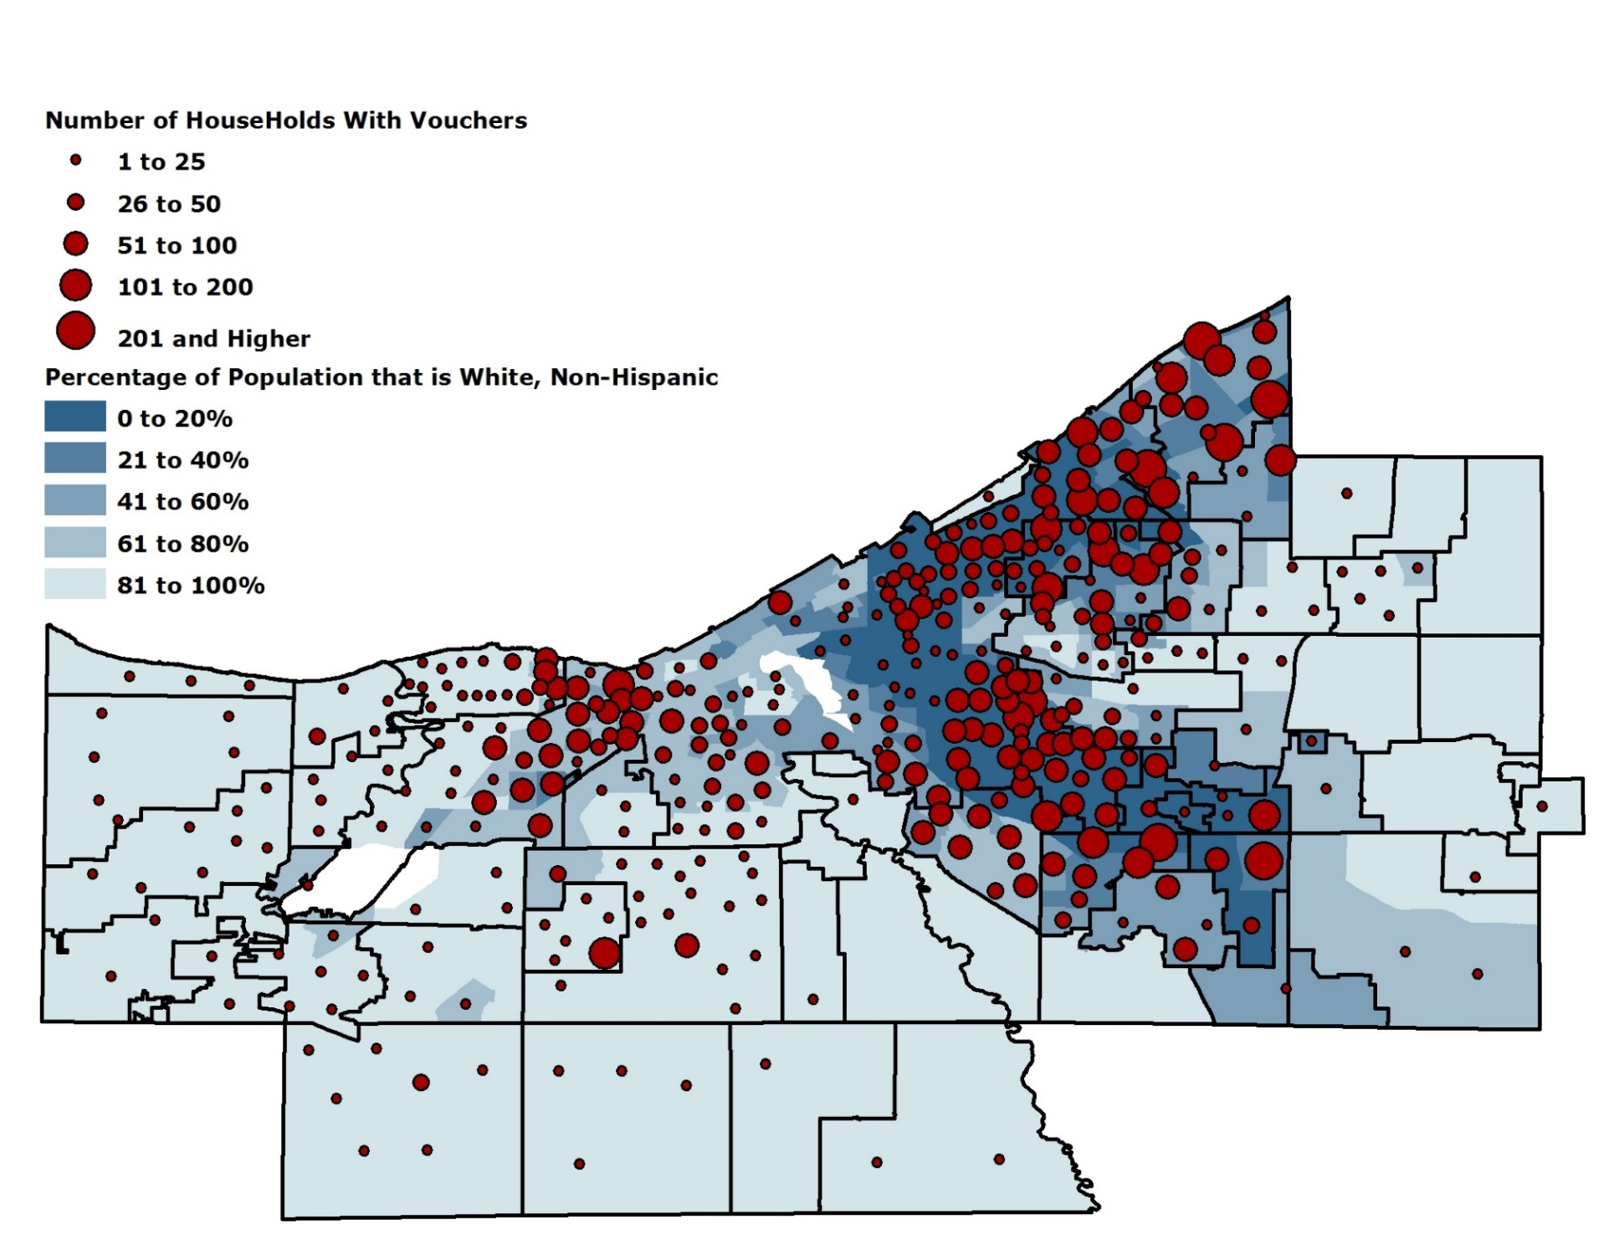
Households with Vouchers and Minority Concentrations in Cuyahoga County.

Slide 6
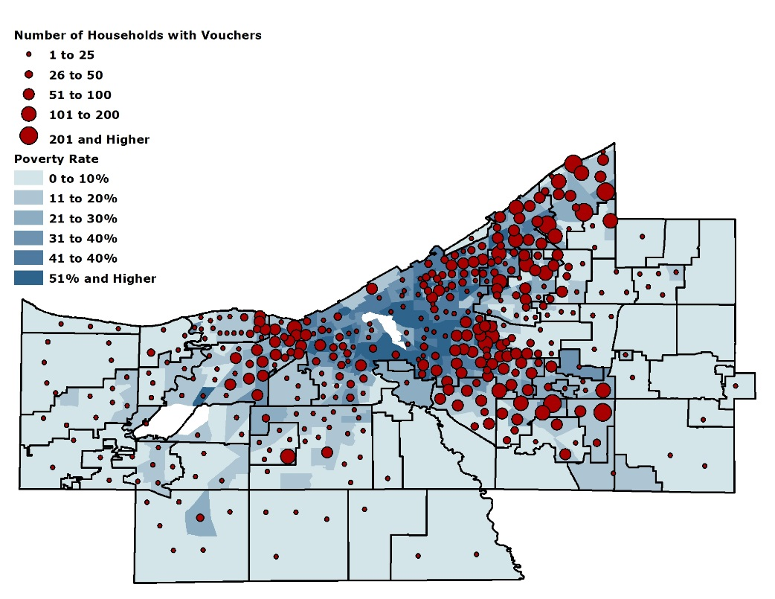
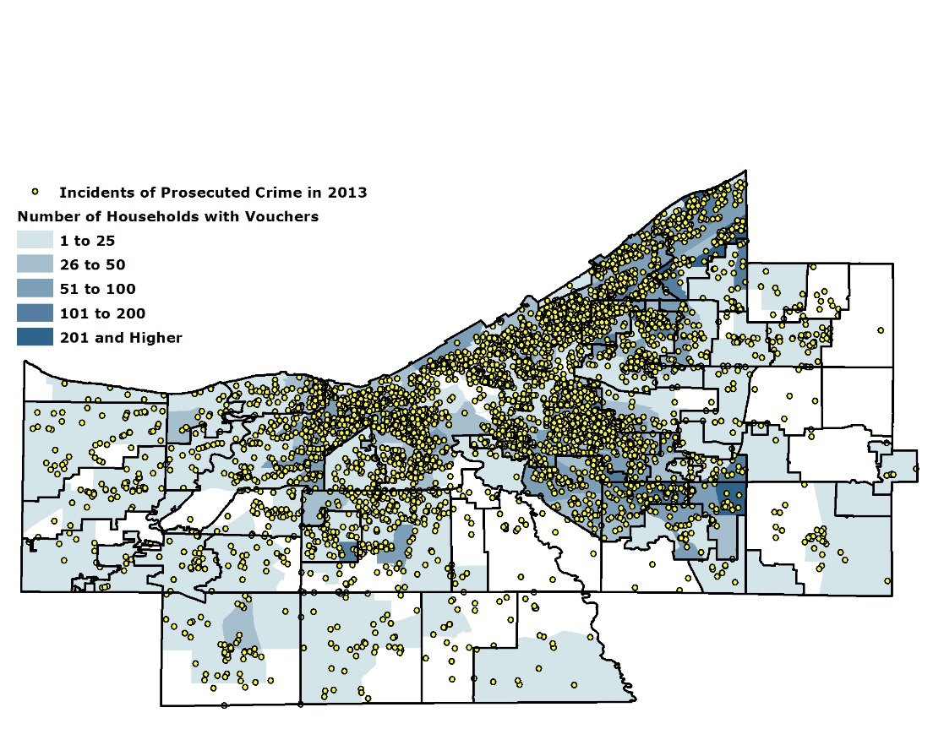
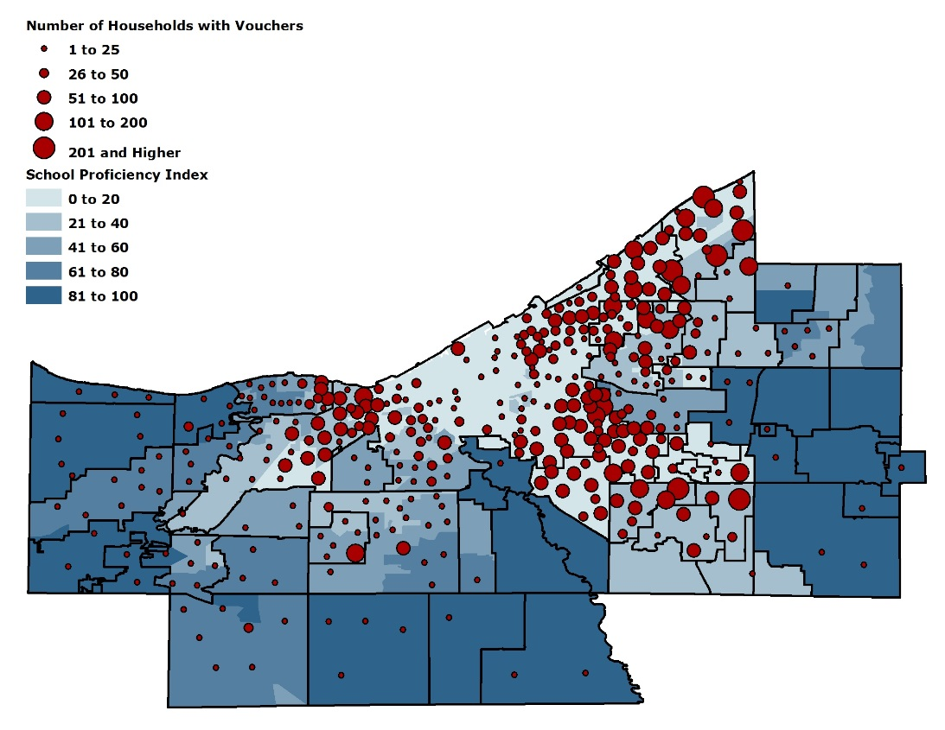
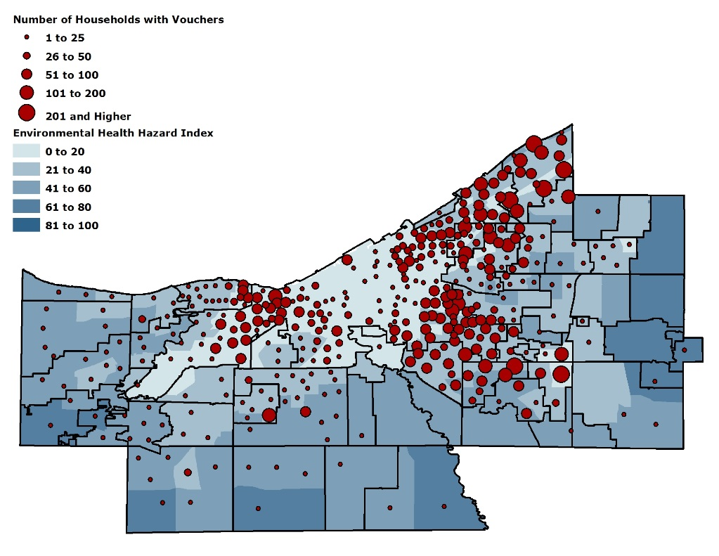
Poverty Rate
Incidents of Crime
School Proficiency
Exposure to
Environmental Hazards

Slide 7
Factors Important to Voucher Holders When Seeking Housing

Slide 8
Challenges Reported by Voucher Holders

Slide 9
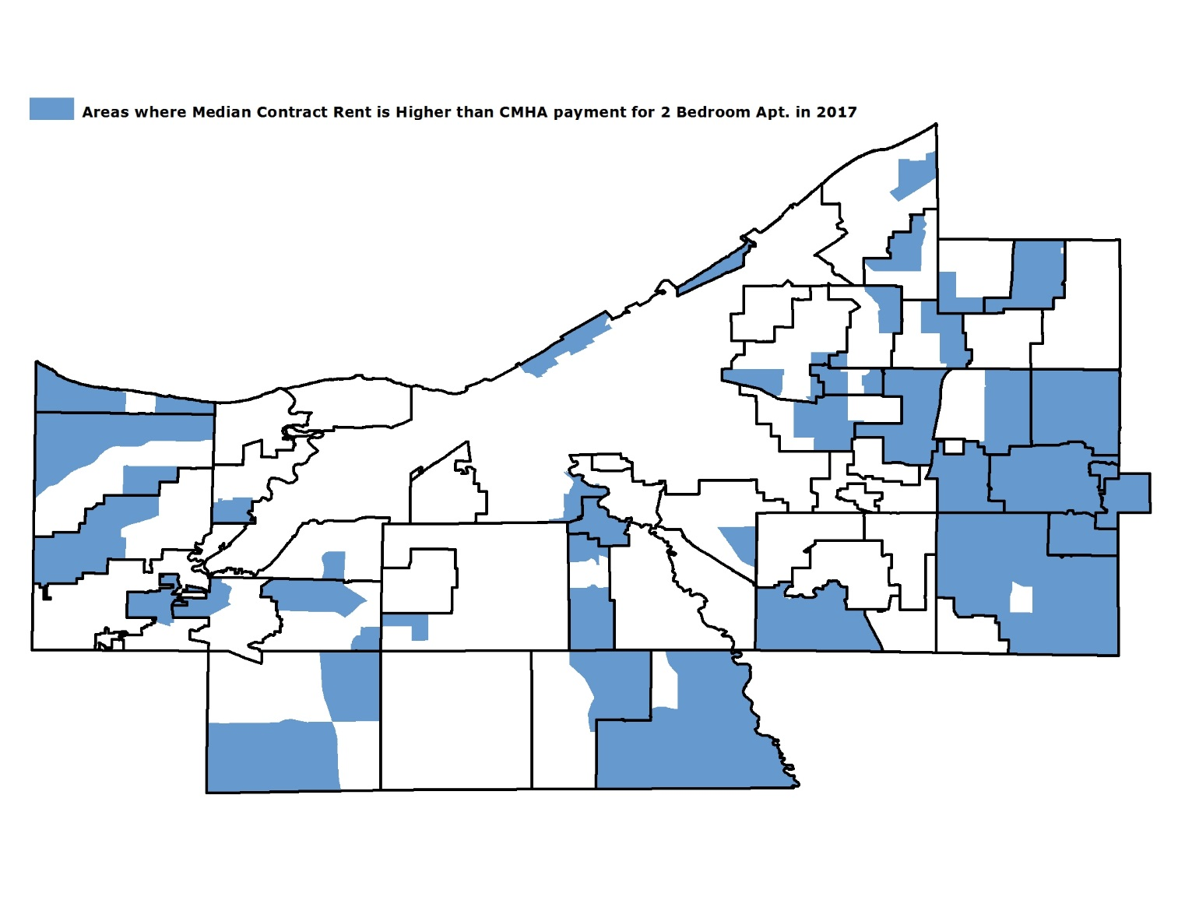
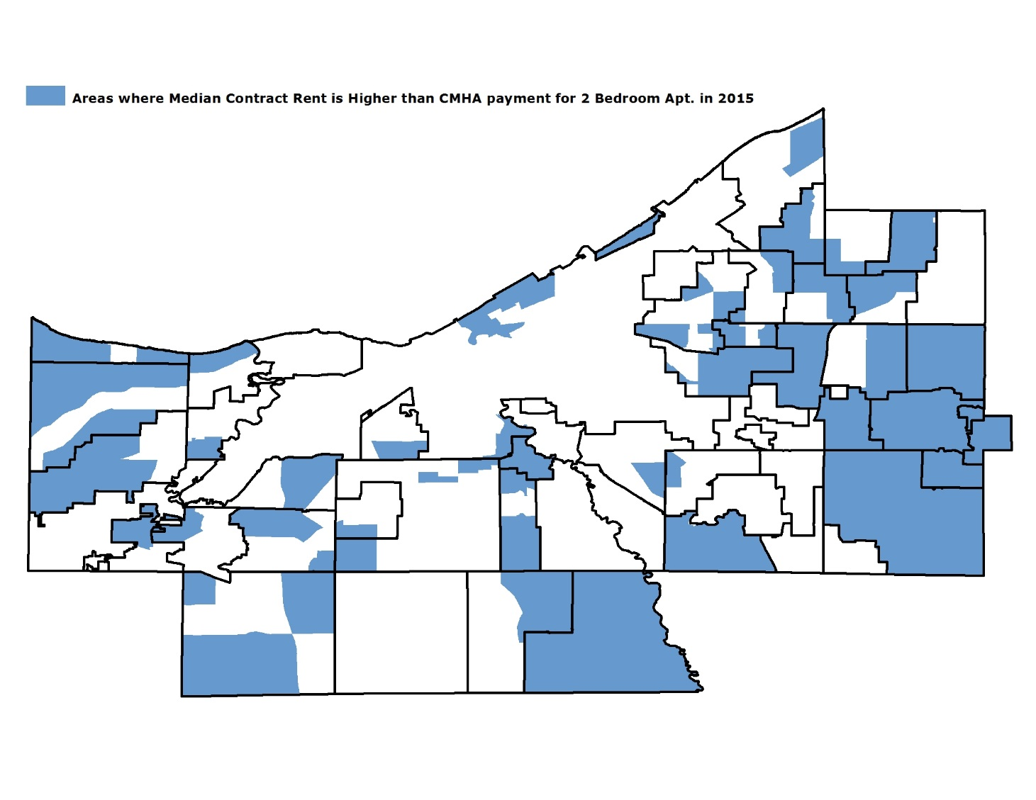
Areas where median contract rent is higher than CMHA’s payment standard for a two-bedroom apartment:
In 2015:
In 2017:

Slide 10
What a Public Housing Authority can do:
Implement Small Area Fair Market Rent
Comprehensive Mobility Counseling Program
Counselor assigned to each resident
Increase in rental subsidy
Security Deposit Assistance
What a community can do:
Ban discrimination of housing vouchers at a regional level

